Slide 2
Team name:
BLACK SQUAD
Team members details:
D.JAMAL ASRAF
G.SANJAI
M.MUTHARASU
S.SIVARAMAN

Slide 3
Title of your project:
GLUCOSE NOTIFIER
Explain the problem statement in your own words:
The problem arises when empty glucose bottles inadvertently draw blood after delivering glucose, posing potential health risks such as unintended blood loss and discomfort for patients If its go long hand gets injured more blood loss and risk dieses may arises. Our project addresses this issue by implementing a sensor-based alert system that notifies healthcare providers to replace the bottle promptly, thereby preventing these complications and ensuring patient safety.

Slide 4
How important it is to solve this problem? What are the pains to be relieved and gains to be created? This problem is critically important in the medical field because glucose bottles, intended to supply glucose to the bloodstream, can inadvertently draw blood once they are empty. This can lead to complications for patients. Our project addresses this issue by implementing a notification system that alerts doctors and nurses before the bottle runs out of glucose. These notifications will include the patient's bed number, ensuring healthcare providers can promptly replace the bottle to prevent unintended blood draws. By preventing such incidents, we aim to improve patient safety and streamline medical procedures, ultimately enhancing the overall quality of care in healthcare settings.

Slide 5
Proposed Solution:
The issue at hand in the medical field involves glucose bottles designed to deliver glucose to the bloodstream. Once the glucose supply is depleted, these bottles can inadvertently draw blood, potentially causing problems such as blood loss and discomfort for the patient. Our project aims to mitigate these issues by implementing a proactive notification system. This system will alert healthcare providers before the bottle runs empty, allowing for timely replacement and minimizing the risk of unintended blood drawing. By addressing this challenge, we seek to enhance patient safety and comfort during medical treatments, thereby improving overall care delivery in healthcare environments.

Slide 6
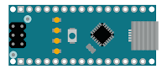
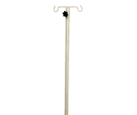
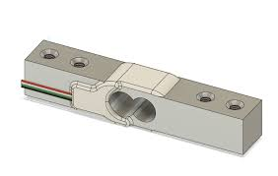
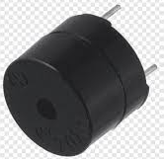
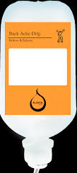
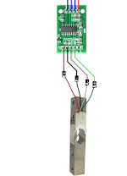
Working:
GLUCOSE
EMBTY
FULL
0
1
NOTHING
BUZZER ON
NOTHFICATION
ON MOBILE AND WATCH

Slide 7
Technological stack of your solution: A spring mechanical system is employed to detect whether a bottle is full or empty. When the bottle is empty, it triggers a signal to an Arduino WiFi Uno device. This Arduino then utilizes the internet to send WhatsApp messages to doctors and nurses, alerting them to the status of the bottle. Additionally, the system activates a buzzer to provide an audible alert. This integrated approach ensures timely notification and response from healthcare providers, enhancing patient care by preventing delays in critical glucose supply management. By leveraging technology in this way, our project aims to improve efficiency and safety in medical environments, ultimately benefiting both healthcare professionals and patients.
HARDWARE:
WOMEN D1 (ESP8622)
BUZZER
LOAD CELL (OR) IR SENSOR
POWER SUPPLY
SOFTWARE:
AURDINO IDE
FIREBASE
CUSTOM APP USING ANDROID STUDIO “GLUCOSE NOTIFY”

Slide 8
Novelty of your project:
A standout feature of our project is its capability to send notifications directly to doctors' and nurses' mobile phones and watches via a Python WhatsApp bot. This innovative system is designed to alert healthcare professionals in real-time when a glucose bottle approaches empty status. By leveraging this technology, our project ensures swift awareness and response, enabling timely replenishment of glucose supplies and minimizing the risk of inadvertent blood drawing. This proactive approach not only enhances patient safety by preventing potential complications but also streamlines workflow efficiency in medical settings. Through the integration of advanced notification systems, we aim to contribute to improved healthcare delivery and better patient outcomes.

Slide 9
Application of your Proposed Solution:
Target Benefits:
Efficiency: The project aims to enhance efficiency in a specific process. For example, if it's related to healthcare, it might improve patient monitoring, reduce manual intervention, or automate routine tasks.
Cost Reduction: By automating or optimizing processes, there can be significant cost savings, reducing labor costs, resource wastage, or operational expenses.
Improved Accuracy: The use of technology often results in more accurate results, reducing errors and improving overall quality of outcomes.
Time Savings: Automating processes typically leads to faster completion of tasks, which can be crucial in time-sensitive environments like hospitals or emergency services.
Scalability: The system is designed to handle a growing number of users or tasks without a significant drop in performance, making it suitable for broader applications.
Scope for Scaling Up:
Integration with Other Systems: The project can be scaled by integrating with other existing systems, such as hospital management software or IoT devices, to create a more comprehensive solution.
Wider Implementation: If initially implemented in a single department or location, the project could be scaled to cover an entire organization or multiple locations, increasing its impact.
Customization and Adaptation: The solution can be customized for different environments or industries, making it adaptable to various needs and expanding its applicability.
Technological Advancements: Incorporating new technologies like AI or machine learning could further enhance the project’s capabilities, making it more robust and intelligent.
Global Reach: If the solution is successful locally, it could be adapted for use in different regions or countries, addressing similar needs on a global scale.

Slide 10
Dependencies of your solution:
On page 6, the diagram illustrates the load mechanical system where the load pulls a cell. When the glucose bottle is full. When the bottle gets empty the cell detect it then sends a signal to the Arduino WiFi module. Subsequently, the Arduino WiFi module initiates the transmission of messages to doctors and nurses. This system ensures that healthcare providers are promptly notified when the glucose supply needs replenishing, thereby optimizing patient care and preventing complications such as unintended blood drawing. The integration of these components demonstrates our project's commitment to enhancing medical efficiency through innovative technological solutions.

Slide 11
Components used:
HARDWARE:
WOMEN D1 (ESP8622)
BUZZER
LOAD CELL (OR) IR SENSER
POWER SUPPLY
SOFTWARE:
AURDINO IDE
FIREBASE
CUSTOM APP USING ANDROID STUDIO “GLUCOSE NOTIFY”

Slide 12

YouTube link for Project demo
GLUCOSE NOTIFIER
https://youtu.be/LN1wOkzfAmM?si=JY2HL38GBufn-JXx

Slide 13
Thank you

